Slide 1
Evidence on EU monetary system

Slide 4
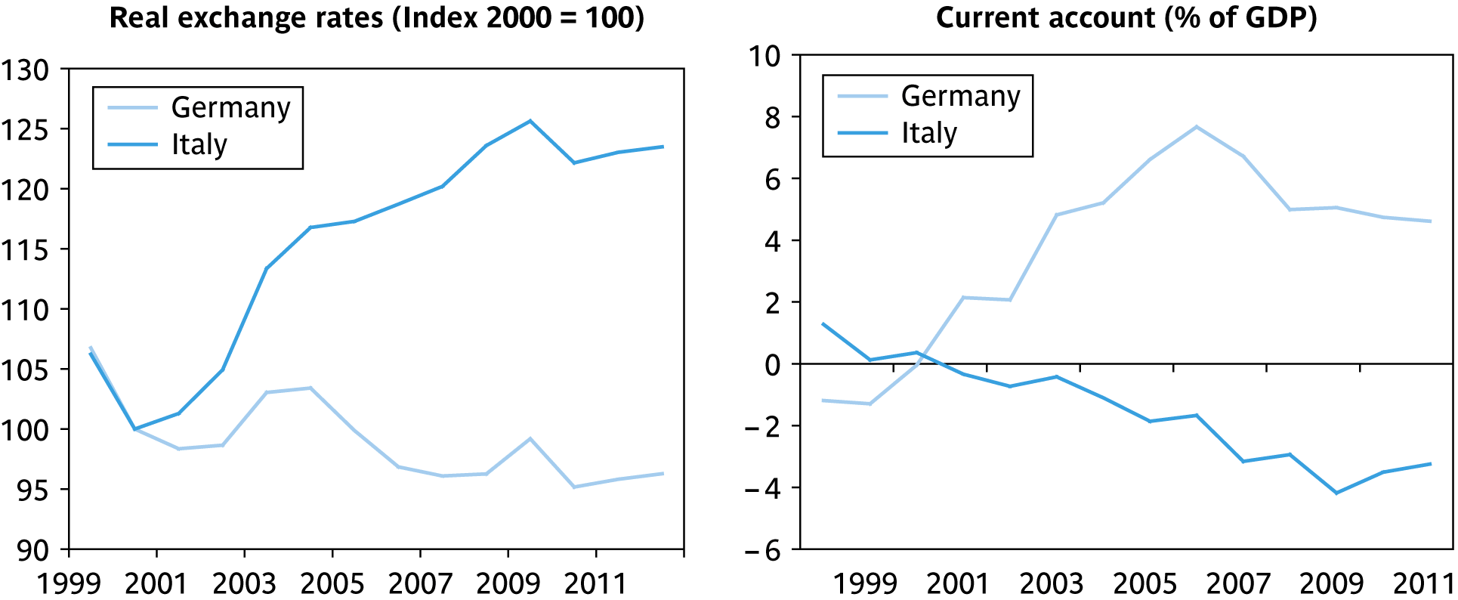
Criterion 5: homogeneous preferences
Currency union member countries must share a wide consensus on the way to deal with shocks.
Germany and Italy: a difficult relationship:

Slide 5
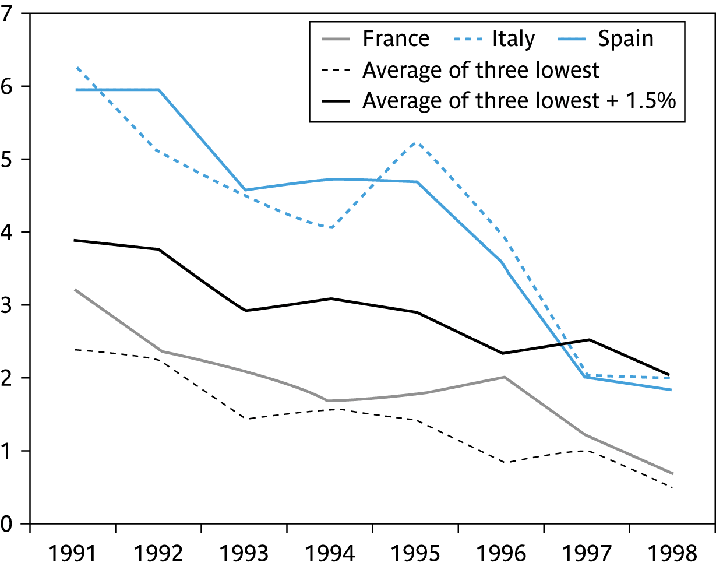
The Maastricht Treaty: five entry conditions
A selection process to certify which countries had adopted a ‘culture of price stability’ (i.e., German-style low inflation): countries have to fulfill five convergence criteria:
inflation: not to exceed by more than 1.5 percentage points the average of the 3 lowest inflation rates among EU countries;

Slide 6
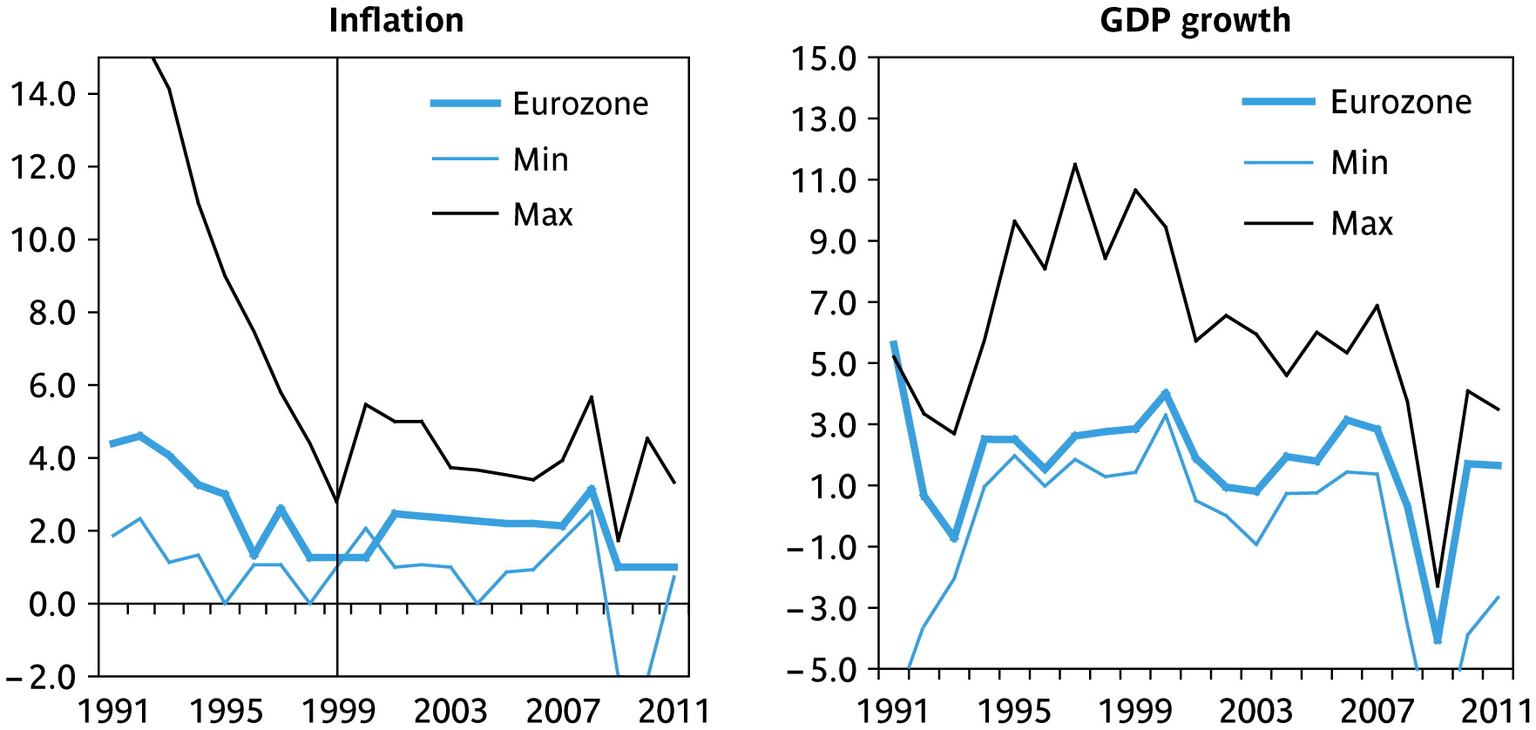
The first years (until the Great Crisis)
Asymmetries: some evidence of decrease:

Slide 7
Interpretation of the convergence criteria: inflation
Straightforward fear of allowing in unrepentant inflation-prone countries

Slide 8
The debt and deficit criteria in 1997

Slide 9
Implication for bond markets: the facts
Long-term rates | Short-term rates

